Slide 1
COMP0118 Analysis of MRI T2 Relaxometry
Francesco Seracini – Chongpo Shao – Pragya Sinha – Ethan Stephenson – Xinyu Tian

Slide 2


Introduction
Aim:
Estimate brain tissue T2 relaxation values using MRI images.
Why T2 Relaxation?
Reflects tissue differences (healthy vs. diseased).
Essential for clinical diagnosis (tumors, inflammation) and neurological studies.
Single T2 Component
Two T2 Components (complex tissues)

Slide 3
Data and Tasks
Data
six datasets with multi-echo T2 data, echo times, brain masks, segmentation, and parcellation files for analysis.
Task1: Identifying Imaging Issues
Task2: Single-Component Model Fitting
Task3: Two-Component Model Fitting
Task4: Model Comparison by AIC

Slide 4
MRI T2 Relaxometry for preterm born infants

Slide 5
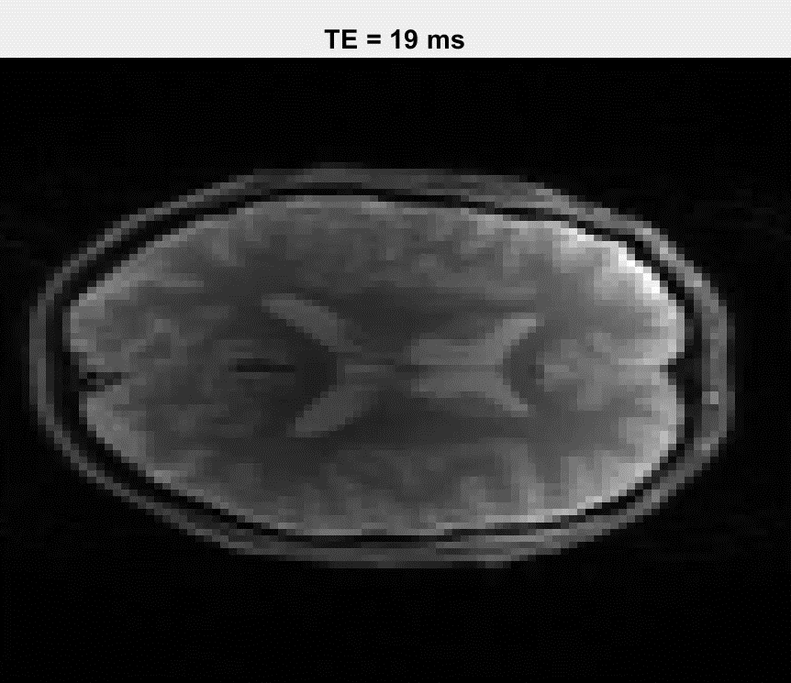
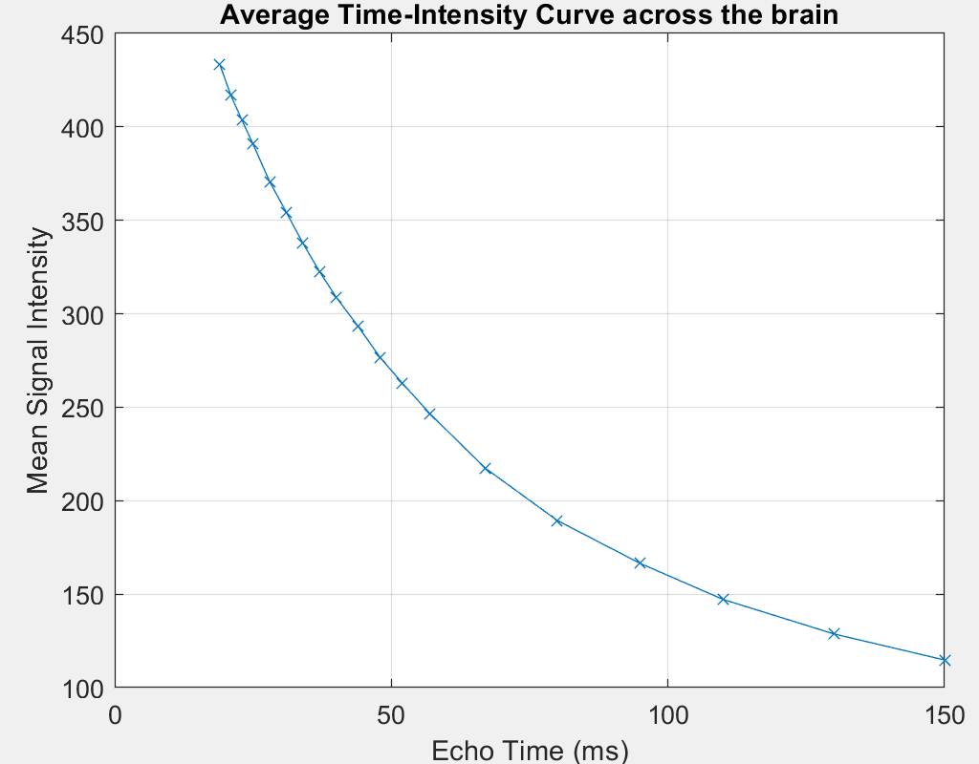
T2 Decay

Slide 6
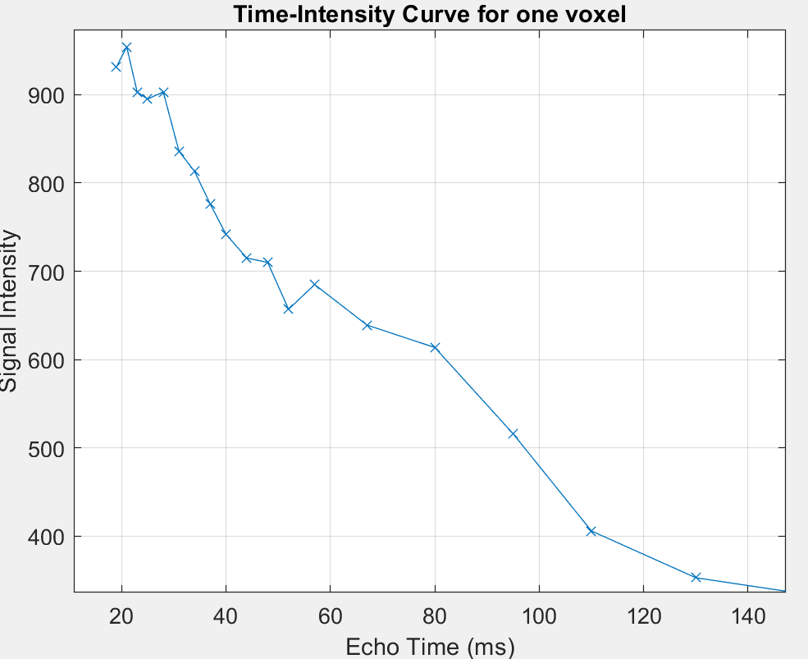
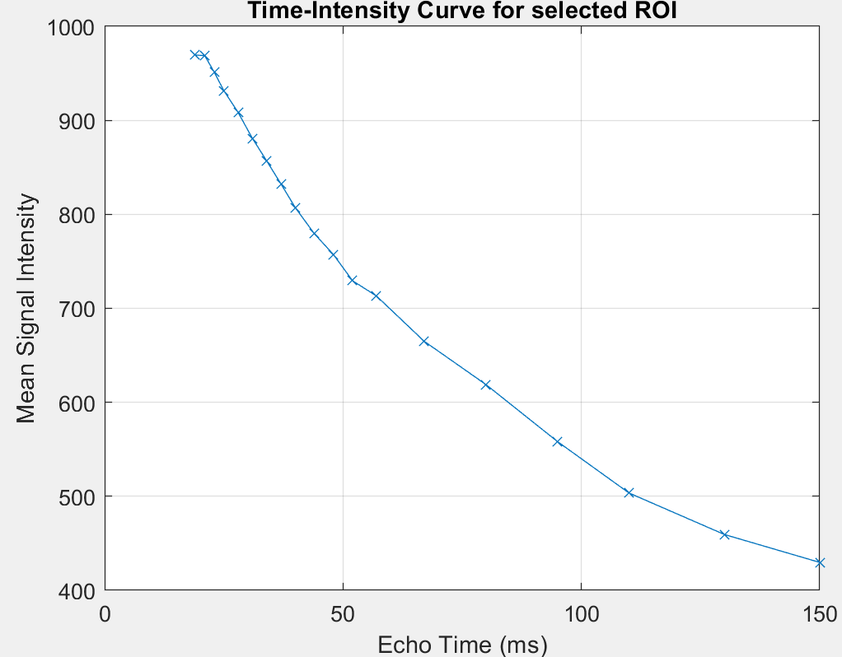
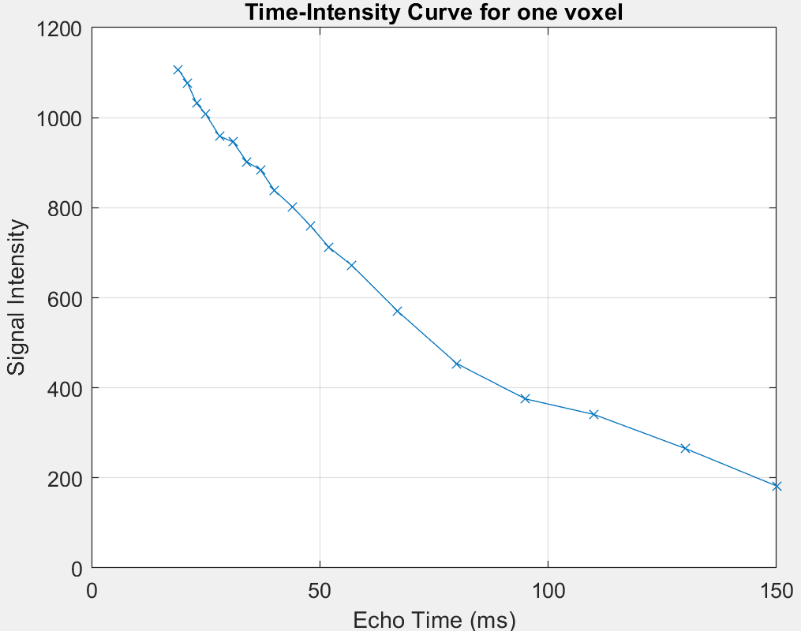
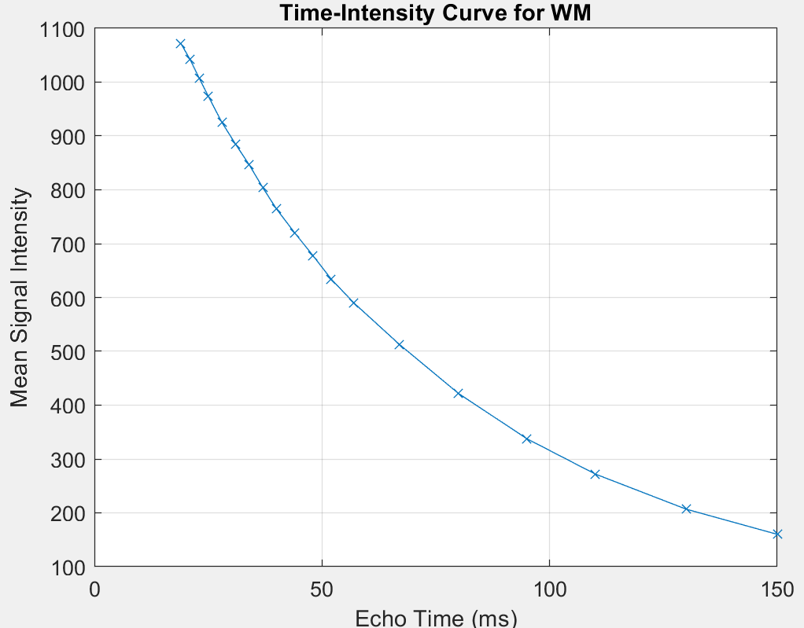
Image Acquisition Problems
Noise
Patient motion
Different tissue compartments

Slide 7
T2 Estimate
ALGORITHM | ERROR | COMPUTATIONAL TIME | SCORE
Two Points
Linear Least-Squares
Weighted Least-Squares
Non-Linear Least-Squares
Non-Negative Least-Squares
Here images of T2 maps

Slide 8
Two compartments model
Voxels containing a mixture of different tissues, do not conform to a single-exponential model
Here T2 and v maps
$$S\left(TE\right)= S_{0}\left[v_{1}∗ e^{\left\{−\frac{TE}{T2_{1}}\right\}}+ \left(1 − v_{1}\right)∗ e^{\left\{−\frac{TE}{T2_{2}}\right\}}\right]$$
STRUCTURE | T2_1 AVERAGE | T2_2 AVERAGE | v AVERAGE | T2_1 STD | T2_2 STD | V STD
CSF
GM
WM

Slide 9
Two compartments model
The average value and confidence intervals of CSF, GM, WM
STRUCTURE | Parameter | Mean | Confidence intervals
WM | T2 (short) | 35.24 | 35.114 - 35.372
 | T2 (long) | 81.50 | 81.191 - 81.816
 | V | 0.313 | 0.311 - 0.314
GM | T2 (short) | 34.193 | 34.051 - 34.336
 | T2 (long) | 116.99 | 115.940 - 118.056
 | V | 0.267 | 0.266 - 0.269
CSF | T2 (short) | 31.2 | 30.996 - 31.404
 | T2 (long) | 529.43 | 521.052 - 537.810
 | V | 0.279 | 0.277 - 0.281
Notes:
First, the three regions have similar short T2 components, about 30-35, which is in the range of typical myelin water (10-50 ms). The white matter region shows a short T2 component of about 35.2 milliseconds, a long T2 component of about 81.5 milliseconds, and a myelin water fraction (V1) of 0.313. It shows the highest short T2 component volume fraction V, which is consistent with its high myelin content. The gray matter region has a significantly longer long T2 component (117 milliseconds), and the myelin water fraction drops to 0.267. Reflecting the lower myelin content of gray matter. The long T2 component of CSF reaches over 500 milliseconds, which is much higher than other tissues, consistent with its fluid characteristics. The confidence intervals for all measured parameters are narrow, indicating that the estimates have good statistic stability.

Slide 10
Models comparison
Here the residuals maps of the 2 compartments and of the best 1 compartment. Each one with the error value under it
MODEL | AIC | BIC

Slide 11
Further research directions
More compartments
Improve the fitting in presence of noise
Differences between preterm and full term infants

